Slide 1
Transfer Learning and Auto Encoding Unit 6
Daniel Acuna
acuna.io

Slide 2
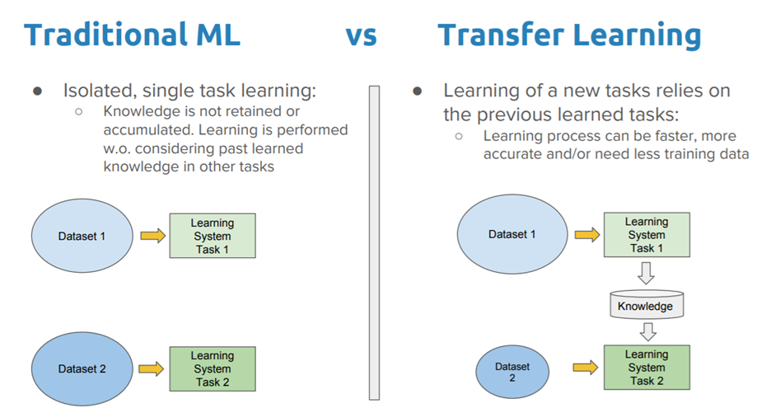
What is Transfer Learning ？
Traditional Machining Learning models are developed from scratch based on specific datasets. The models are trained in isolation for a specific application.
No knowledge is retained which can be transferred from one model to another.
In transfer learning, you can leverage knowledge (features, weights etc) from previously trained models for training newer models and even tackle problems like having less data for the newer task!
Reference
https://towardsdatascience.com/a-comprehensive-hands-on-guide-to-transfer-learning-with-real-world-applications-in-deep-learning-212bf3b2f27a

Slide 3
Considerations for Transfer Learning
Transfer learning provides us the ability to utilize existing knowledge from pre-trained models. When considering transfer learning, the following three important questions must be answered:
What to transfer
We need to identify which part of the knowledge can be transferred from the source to the target in order to improve the performance of the target task.
When to transfer:
There can be scenarios where transferring knowledge for the sake of it may make matters worse than improving anything (also known as negative transfer).
We should aim at utilizing transfer learning to improve target task performance/results and not degrade them. We need to be careful about when to transfer and when not to.
How to transfer:
Identifying ways of actually transferring the knowledge across domains/tasks. This involves changes to existing algorithms and different techniques
Reference
https://towardsdatascience.com/a-comprehensive-hands-on-guide-to-transfer-learning-with-real-world-applications-in-deep-learning-212bf3b2f27a

Slide 4
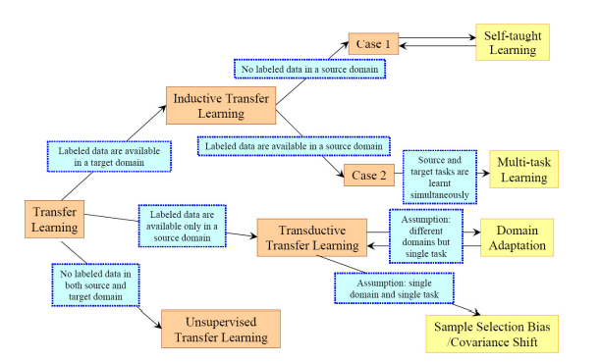
Transfer Learning Strategies
Inductive Transfer learning: In this scenario, the source and target domains are the same, yet the source and target tasks are different from each other. The algorithms try to utilize the inductive biases of the source domain to help improve the target task.
Unsupervised Transfer Learning: In this scenario the source and target domains are similar, but the tasks are different. For instance when labeled data is unavailable in either of the domains.
https://www.cse.ust.hk/~qyang/Docs/2009/tkde_transfer_learning.pdf
Transductive Transfer Learning: In this scenario, there are similarities between the source and target tasks, but the corresponding domains are different.
Reference
https://towardsdatascience.com/a-comprehensive-hands-on-guide-to-transfer-learning-with-real-world-applications-in-deep-learning-212bf3b2f27a

Slide 5
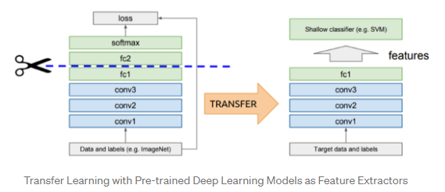
Using Off-the-shelf Pre-trained Models as Feature Extractors
As we have seen, deep learning models utilize layered architectures that learn different features at different layers.
These layers are then finally connected to a last layer (usually a fully connected layer, in the case of supervised learning) to get the final output.
This layered architecture allows us to utilize a pre-trained network (such as Inception V3 or VGG) without its final layer as a fixed feature extractor for other tasks.
Reference
https://towardsdatascience.com/a-comprehensive-hands-on-guide-to-transfer-learning-with-real-world-applications-in-deep-learning-212bf3b2f27a

Slide 6
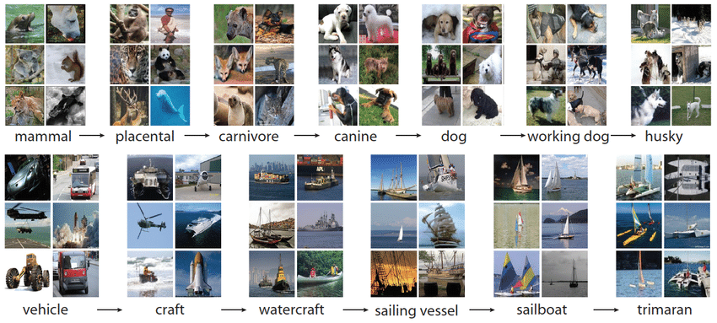
ImageNet
The ImageNet project is a large visual database designed for use in visual object recognition software research.
More than 14 million images have been hand-annotated by the project to indicate what objects are pictured and in at least one million of the images, bounding boxes are also provided.
ImageNet contains more than 20,000 categories with a typical category, such as "balloon" or "strawberry", consisting of several hundred images.
Reference
https://en.wikipedia.org/wiki/ImageNet
https://devopedia.org/imagenet

Slide 7
Pre-trained Models for Computer Vision
Pre-trained models are usually shared in the form of the millions of parameters/weights the model achieved while being trained to a stable state.
VGG-16 - An architecture trained on ImageNet with very small (3x3) convolution filters with depth to 16-19 weight layers
VGG-19 - An architecture trained on ImageNet that 19 layers deep and can classify images into 1000 object categories, such as a keyboard, mouse, pencil, and many animals..
Reference
https://towardsdatascience.com/a-comprehensive-hands-on-guide-to-transfer-learning-with-real-world-applications-in-deep-learning-212bf3b2f27a

Slide 8
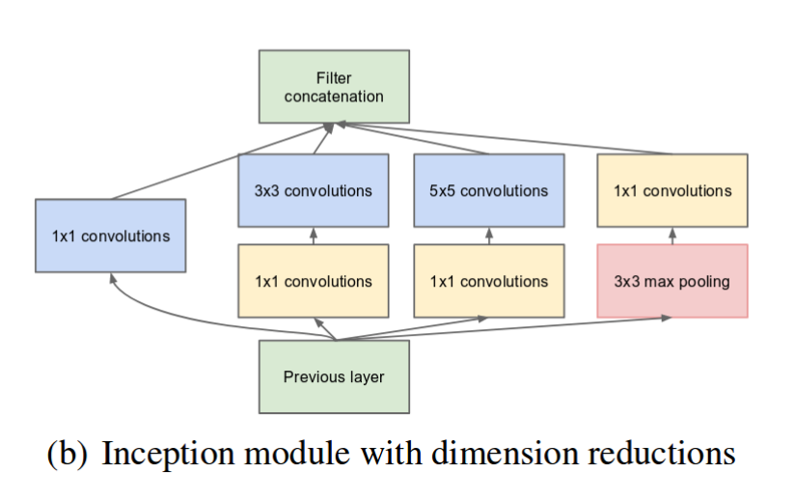
Pre-trained Models for Computer Vision
Inception – as neural networks get deeper, it is harder to pass gradients closer to the input layers. Inception proposes to make the network wider instead of deeper
Reference
https://towardsdatascience.com/a-comprehensive-hands-on-guide-to-transfer-learning-with-real-world-applications-in-deep-learning-212bf3b2f27a

Slide 9
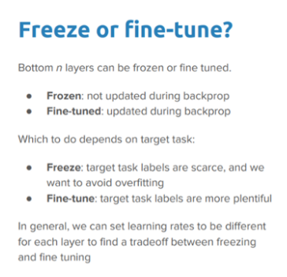
Freeze or Fine-tune the Pre-trained Model
As we have seen, Deep neural networks are highly configurable with many hyperparameters that are used for tuning the model.
We have also learned that initial layers capture generic features, while the later ones focus more on the specific task at hand.
One decision we need to make is do we freeze the pre-trained model (use the models fix weights) or fine-tune the pre-trained models to suit our needs.
Reference
https://towardsdatascience.com/a-comprehensive-hands-on-guide-to-transfer-learning-with-real-world-applications-in-deep-learning-212bf3b2f27a

Slide 10
Decisions around Tuning
We need to determine if to use all layers, or remove some
To do this we need to remove some number of last hidden layers (at end) to adjust model to a specific applications
If we remove layers, we need to make sure shape matches between
We removing layers we have to make sure that that the dimensions of the input and output layers are the same or will throw errors.

Slide 11
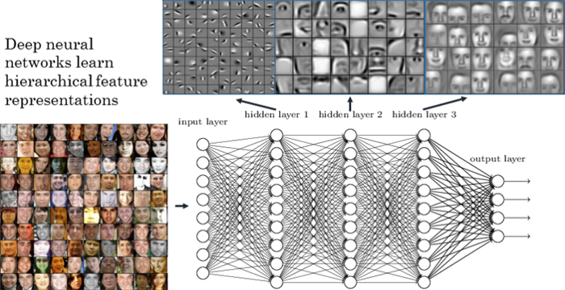
Fine Tuning Off-the-shelf Pre-trained Models
This is a more involved technique, where we do not just replace the final layer (for classification/regression), but we also selectively retrain some of the previous layers.
We may choose to freeze certain layers while retraining, or fine-tuning, the rest of the layers to suit our needs.
These techniques can help us achieve better performance with less training time.
Reference
https://towardsdatascience.com/a-comprehensive-hands-on-guide-to-transfer-learning-with-real-world-applications-in-deep-learning-212bf3b2f27a

Slide 12
How to use a Pre-trained model
In depth example: https://keras.io/guides/transfer_learning/

Slide 13
Do it yourself for the flower dataset
Get in your group and try the following activity https://colab.research.google.com/github/daniel-acuna/applied_deep_learning/blob/master/CNN/transfer_learning_flowers.ipynb

Slide 14
Auto encoders

Slide 15
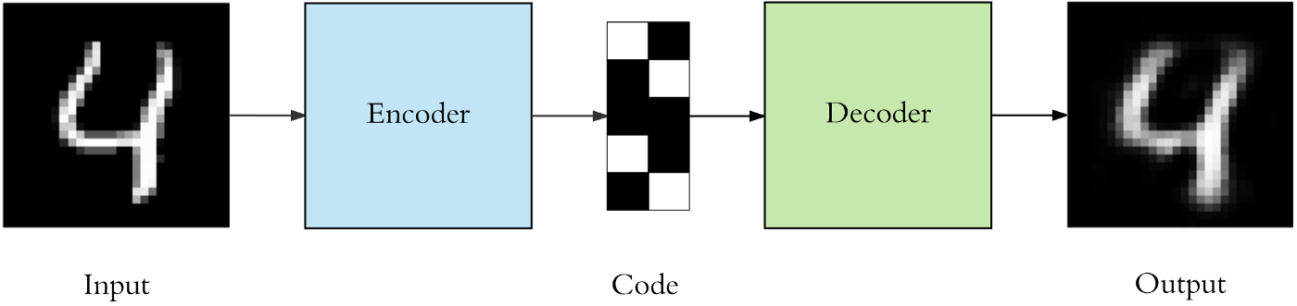
What are Autoencoders?
Autoencoders are a type of neural network that attempts to mimic its input as closely as possible to its output. It aims to take an input, transform it into a reduced representation called code or embedding. Then, this code or embedding is transformed back into the original input. The code is also called the latent-space representation.
Formally, we can say, an autoencoder describes a nonlinear relationship of an input to an output through an intermediate representation called code or embedding.
The main purpose is to learn a reduced representation of the input data.
https://medium.com/swlh/introduction-to-autoencoders-56e5d60dad7f

Slide 16
Some of the important things to know about the autoencoders are:
Some of the important things to know about the autoencoders are:
Data-specific compression: Autoencoders compresses the data that is similar to what it had been trained on. An autoencoder trained on dog photos cannot compress human faces photos easily.
Unsupervised: Training an autoencoder is easy as we don’t need labelled data. It is easily trained on any kind of input data.
Lossy in nature: There is always going to be some difference between the input and output of the autoencoder. The output will always have some missing information in it.
https://medium.com/swlh/introduction-to-autoencoders-56e5d60dad7f

Slide 17
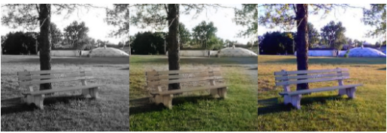
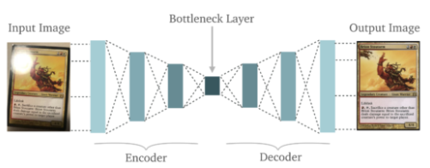
Why are Autoencoders Useful
Autoencoders are used for converting any black and white picture into a colored image. Depending on what is in the picture, it is possible to tell what the color should be.
Autoencoders are used for feature Extraction: They extract only the required features of an image and generates the output by removing any noise or unnecessary interruption.

Slide 18
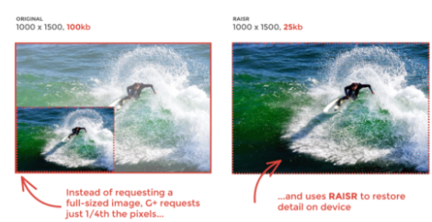
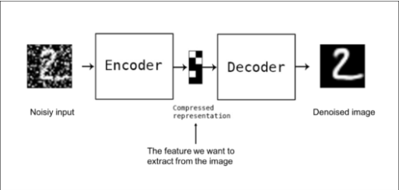
Why are Autoencoders Useful
Autoencoders are used for Dimensionality Reduction
The reconstructed image is the same as our input but with reduced dimensions. It helps in providing the similar image with a reduced pixel value.
Autoencoders are used for Denoising Image. The input seen by the autoencoder is not the raw input but a stochastically corrupted version. A denoising autoencoder is thus trained to reconstruct the original input from the noisy version

Slide 19
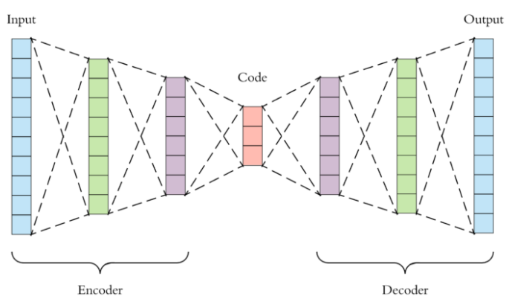
Architecture of Autoencoders
Let’s explore the details of the architecture of the autoencoder. An autoencoder consists of three main components:
Encoder: This part of the network compresses the input into a latent space representation. The encoder layer encodes the input image as a compressed representation in a reduced dimension. The compressed image is the distorted version of the original image.
Code: This part of the network represents the compressed input which is fed to the decoder.
Decoder: This layer decodes the encoded image back to the original dimension. The decoded image is a lossy reconstruction of the original image and it is reconstructed from the latent space representation.
https://www.edureka.co/blog/autoencoders-tutorial/#what-are-autoencoders

Slide 20
Tuning an Autoencoder
When you start building your first autoencoder, you will encounter some of the hyperparameters that will affect the performance of your autoencoder. These hyperparameters are discussed here:
Number of layers: You can keep as many layers in the encoder and decoder as you require. You can also choose how many nodes or units you want in your layers. Usually the number of nodes decreases as we increase the number of layers in the encoder and vice-versa for the decoder.
Number of nodes in the code layer: It is always better to have less number of nodes in this layer than input size. Smaller size of code layer leads to better compression.
Loss: For the loss function, we generally use Mean Squared Error or Binary Cross Entropy. We are going to learn more about the loss function in the next section.
https://medium.com/swlh/introduction-to-autoencoders-56e5d60dad7f

Slide 21
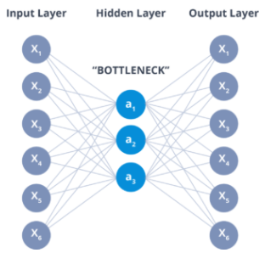
The Bottleneck Layer
The layer between the encoder and decoder, ie. the code is also known as Bottleneck.
This is a well-designed approach to decide which aspects of observed data are relevant information and what aspects can be discarded. It does this by balancing two criteria :
Compactness of representation, measured as the compressibility.
It retains some behaviourally relevant variables from the input.

Slide 22
Let's implement a Autoencoder
https://colab.research.google.com/github/daniel-acuna/applied_deep_learning/blob/master/CNN/auto_encoder.ipynb

Slide 23
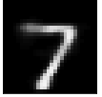
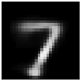
Autoencoder implementation
We can predict the reconstructed image
10
Activity #1: Create deep autoencoder

Slide 24
Exploring auto-encoder
We sometimes want to explore the encoder alone
We sometimes want to explore the decoder alone

Slide 25
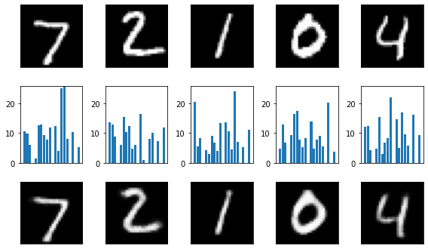
Exploring encoder

Slide 26
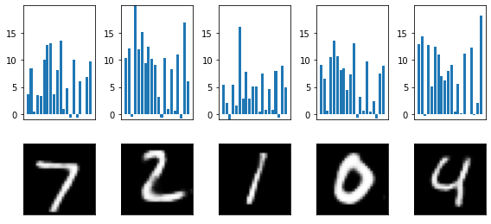
Explore effect of perturbations
Activity #2: more perturbations

Slide 27
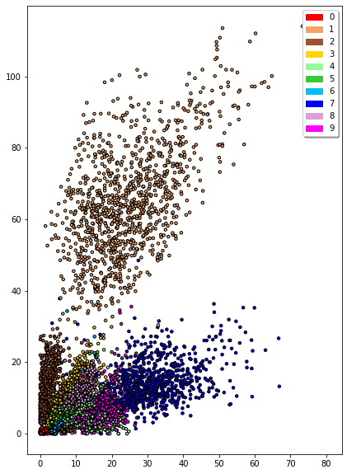
Using encoder to plot
We can use an encoder to draw in 2 dimensions, similar to PCA
2
What can you say about this plot?

Slide 28
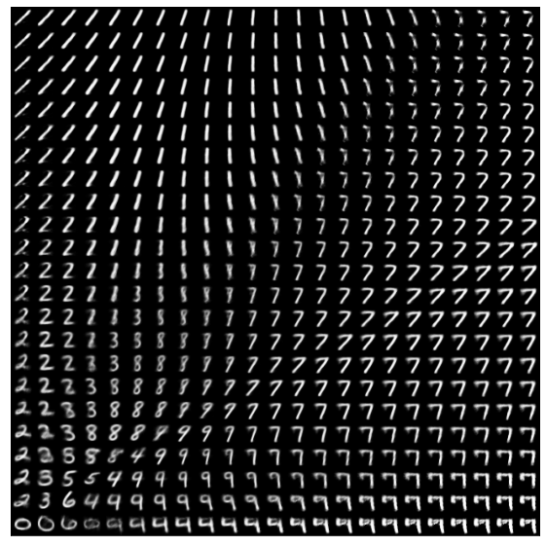
Using decoder to explore encoder

Slide 29
Using decoder to explore encoder
Activity #3: Explore the latent space close to 0 (e.g., from -1 to 10)

Slide 30
Convolutional auto-encoder
MNIST is fundamentally a computer vision dataset
We should use CNNs in the encoder and decoder

Slide 31
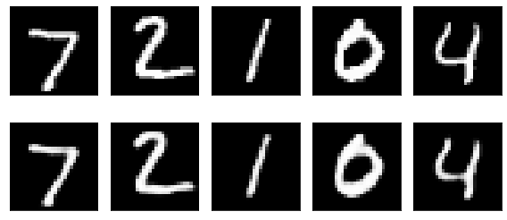
Convolutional auto-encoder (2)
But in the code, how many latent variables were used?
Is this really better?

Slide 32
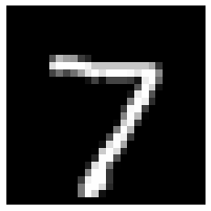
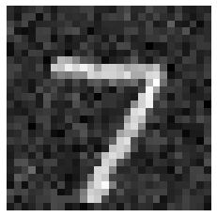
Denoising with autoencoder
Let's add noise to a test input

Slide 33
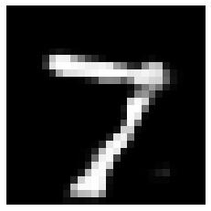
Denoising with autoencoder
Activity #4: Add even more noise (Gaussian with std = 0.4)

Slide 34
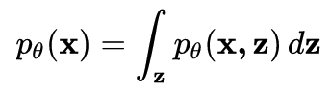
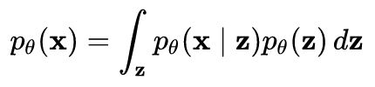
Variational autoencoder
It is a probabilistic view of autoencoding
We assume the data we observe is the marginal distribution over latent variables z
We assume that p(z) is a mixture of Gaussian distributions

Slide 35
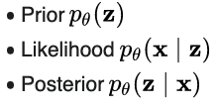
Variational autoencoder (2)
It is a probabilistic (Bayesian) rather than determistic approach
It can work with less data and produces smoother representations

Slide 36
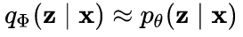
Variational autoencoder (3)
The variational part comes from approximating the posterior (because it is too difficult to compute)

